Slide 1

Department of Computer Science and Engineering
Minor Project
Online Food Delivery Management System using Advanced Data Handling in MongoDB
Presented By:
LONGJAM NIRISH SINGH (ENG25CSE031)

Slide 2
Overview
Abstract
Problem Statement
Introduction
Social/Environmental Impact
Methodology
Design
Deliverables
References

Slide 3
Abstract
This project implements a scalable food delivery platform utilizing MongoDB’s NoSQL architecture. Unlike traditional RDBMS, this system uses a flexible document model to handle diverse menu structures and real-time order tracking. The core focus is on optimizing query performance through Geospatial Indexing for finding nearby restaurants and implementing Aggregation Pipelines for real-time analytics on sales and delivery times.

Slide 4
Problem Statement
Rigid Schemas: Traditional SQL databases struggle with diverse menu structures and frequent item updates.
Geospatial Latency: High computational cost in calculating real-time proximity between users, restaurants, and riders.
Peak-Load Bottlenecks: System lag during high-concurrency periods (e.g., lunch/dinner rushes) due to row-locking.
Scalability Constraints: Difficulty in handling massive "write-heavy" GPS data from thousands of active delivery partners.
Data Silos: Challenges in generating real-time analytics from fragmented relational tables.

Slide 5
Introduction
The Online Food Delivery Management System leverages the power of MongoDB to address the high-velocity and varied data requirements of the modern food tech industry. By moving away from table-based structures, this system utilizes a document-oriented approach that treats menus, user preferences, and order histories as flexible BSON objects. This architecture is specifically designed to handle "Polyglot Persistence" needs, where Geospatial Indexing allows for millisecond-latency in restaurant discovery, and Sharding ensures the system can scale horizontally as the user base grows. By integrating advanced data handling techniques such as the Aggregation Pipeline and Change Streams, the system provides a seamless, real-time experience for customers, restaurant partners, and delivery executives alike.

Slide 6
Social/Environmental Impact
The implementation of an advanced food delivery management system extends beyond technical efficiency, offering significant socio-economic and environmental benefits. Socially, the platform empowers small-scale "Cloud Kitchens" and local vendors by providing them with a sophisticated digital infrastructure that was previously accessible only to large chains, thereby fostering local entrepreneurship and job creation for delivery partners. From an environmental perspective, the system utilizes MongoDB’s geospatial capabilities to implement intelligent route optimization algorithms. By calculating the most efficient delivery paths and enabling "order batching" (delivering multiple orders in one neighborhood), the system significantly reduces the total distance traveled by delivery vehicles, leading to a measurable decrease in carbon emissions and urban traffic congestion. Furthermore, real-time data analytics help restaurants predict demand more accurately, which directly contributes to a reduction in food waste by optimizing inventory management and minimizing overproduction.

Slide 7
Methodology
The development of this system follows a structured MERN Stack methodology focused on modularity and high data throughput:
Requirement Analysis & Data Modeling: Identifying the core entities—Users, Food Items, Carts, and Orders. The methodology prioritizes a schema-less design in MongoDB to accommodate diverse menu attributes and rapid updates without the overhead of relational migrations.
Architecture Setup (MERN): Implementing a decoupled architecture where React.js handles the interactive frontend, and a Node.js/Express backend serves as the RESTful API layer. This ensures a smooth asynchronous user experience during high-traffic order placements.
State Management & Cart Logic: Utilizing React’s Context API or Redux for client-side state management, allowing users to persist cart data seamlessly. The backend validates these states against the MongoDB store to ensure price and inventory integrity.

Slide 8
Methodology
Advanced Data Handling: Utilizing Mongoose for object-document mapping (ODM) to implement sophisticated validation logic and middleware. This includes "Pre-save" hooks for password hashing and "Aggregation Pipelines" to calculate real-time order totals and restaurant analytics.
Secure Transaction Flow: Integration of secure payment gateways (like Stripe) and JWT (JSON Web Tokens) for role-based authentication, ensuring that only authorized users can access the Admin Dashboard or modify order statuses.

Slide 9
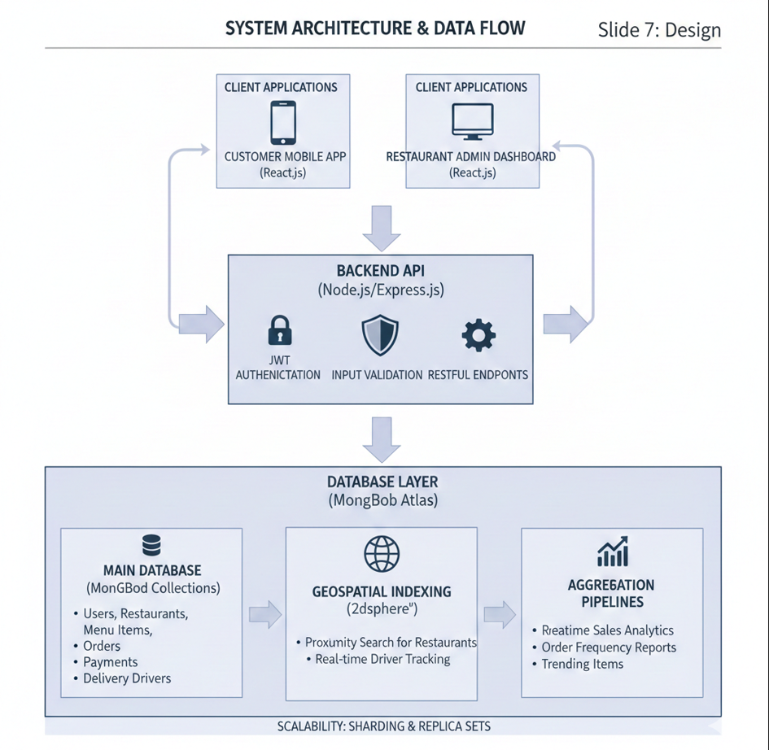
Design

Slide 10
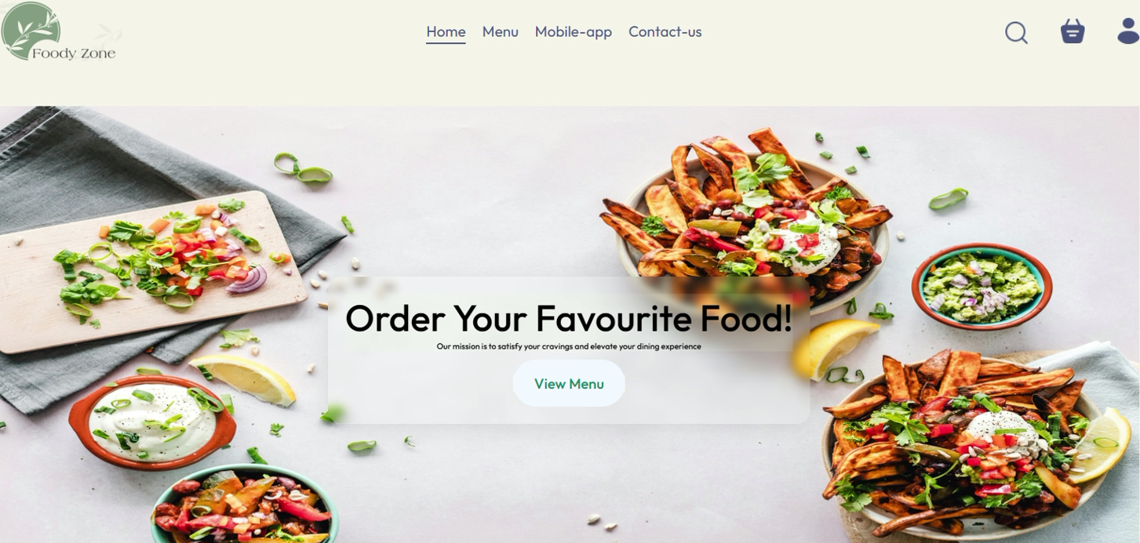
Design- Screen design

Slide 11
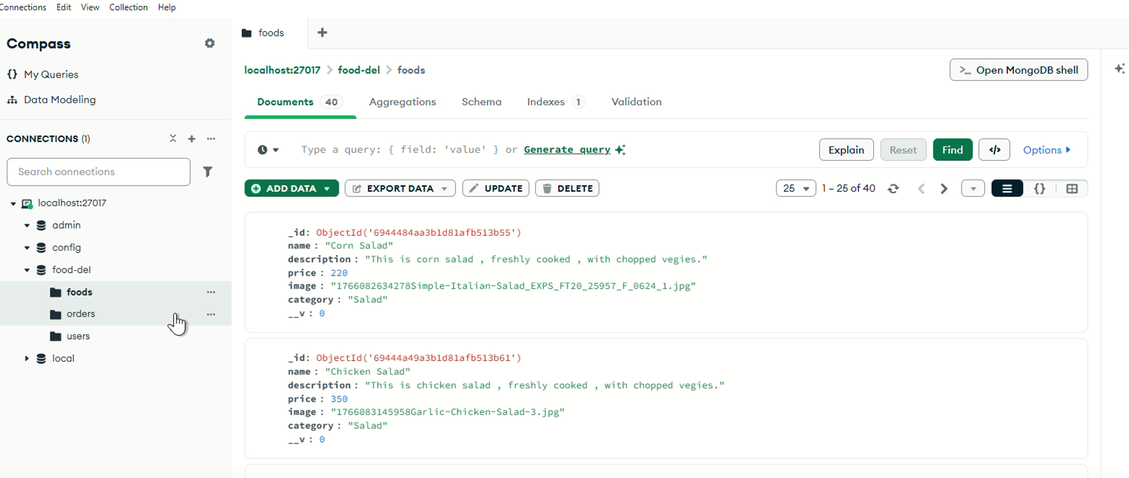
Design- Screen design

Slide 12
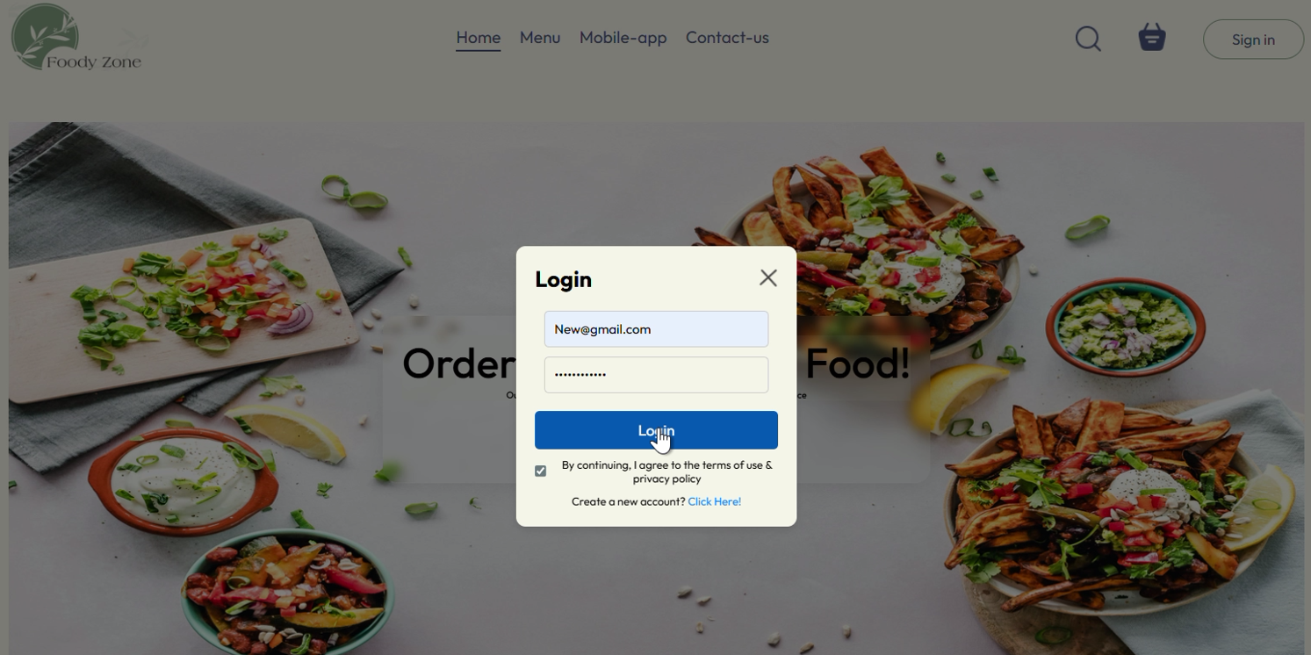
Design- Screen design

Slide 13
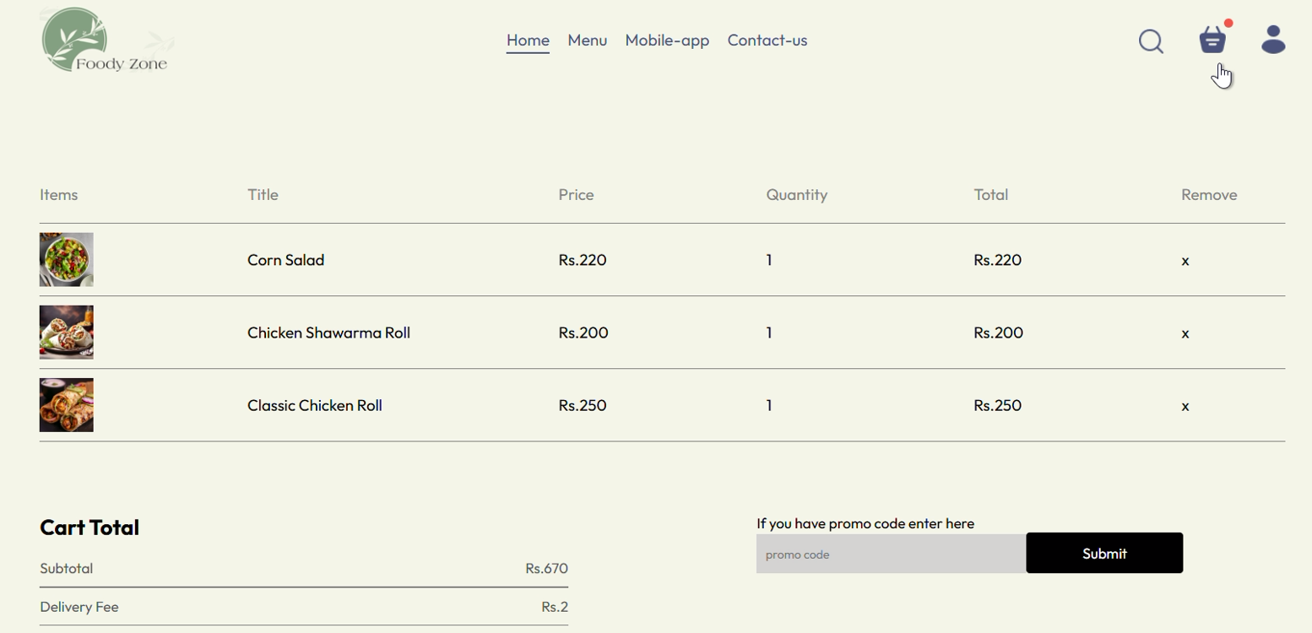
Design- Screen design

Slide 14
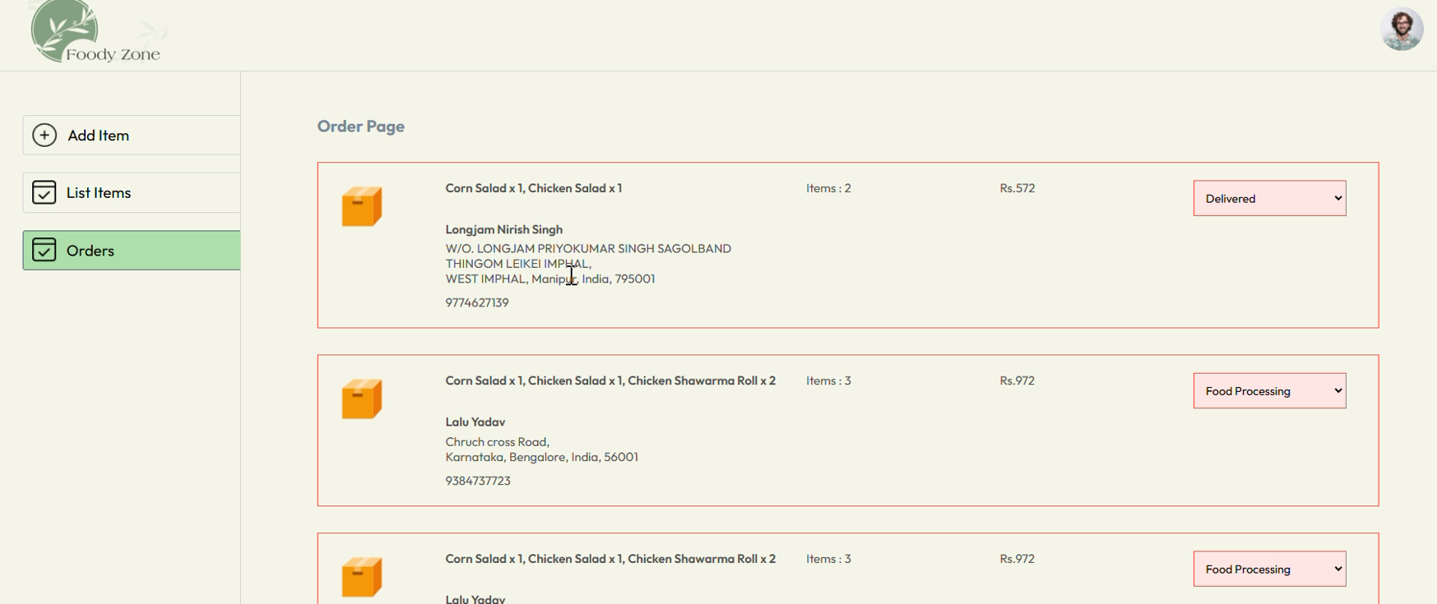
Design- Screen design

Slide 15
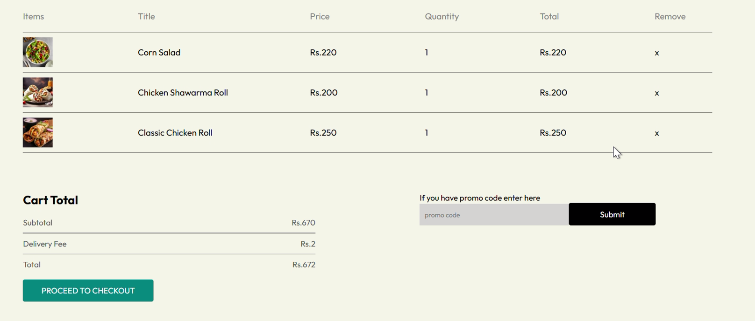
Design- Screen design

Slide 16
Deliverables
.
.
Fully Functional MERN Application: A complete web-based platform featuring a responsive User Interface for customers and a comprehensive Admin Dashboard for restaurant management.
Advanced MongoDB Schema Design: A robust, denormalized data model optimized for high-speed read/write operations, utilizing Embedded Documents and References appropriately.
Geospatial Implementation: Functional proximity-based search logic using MongoDB’s 2dsphere indexing to connect users with the nearest available restaurants.
Secure Authentication System: Implementation of JWT (JSON Web Tokens) and Bcrypt for secure, role-based access control (Admin vs. Customer).
Real-time Order Management: A dynamic order lifecycle tracking system that updates statuses (Pending, Confirmed, Delivered) in real-time.
Aggregation Analytics Engine: A suite of complex MongoDB aggregation pipelines used to generate business insights, such as daily revenue reports and top-selling food items

Slide 17
References
Peer-Reviewed Journals & Reports
Mulla, A. A., et al. (2023). "Designing Web Application of Online Food Ordering for Restaurant Chain using Web Technologies." International Journal of Research in Engineering and Science (IJRES).
Pathan, J., et al. (2024). "Food Ordering Web Application using MERN Stack: A Performance Analysis." International Journal of Trend in Scientific Research and Development (IJTSRD).
Srivastava, M. K. (2021). "Online Food Delivery: Study with Special Reference to Food Aggregators." International Journal of Multidisciplinary Research and Analysis.
Technical Textbooks
Chodorow, K. MongoDB: The Definitive Guide - Powerful Tools for Data Management. O'Reilly Media.
Done, P. Practical MongoDB Aggregations: The Go-to Guide for Data Manipulation and Analysis. Packt Publishing.
H.B. Gupta, et al. (2025). Harnessing the MERN Stack for Scalable E-commerce: A Full-Stack Approach with MongoDB.

